Slide 1

8th Grade Math: Pre-Algebra
Unit 1, Lesson 5 Evaluating Numeric Expressions – Part 2 Volume 1, pg. 26

Slide 2


Benchmark
MA.7.NSO.2.1
Solve mathematical problems using multi-step order of operations with rational numbers including grouping symbols, whole-number exponents, and absolute value.
volume 1, pg. 26

Slide 3
Integrated Mathematical Thinking and Reasoning Standards
MA.K12.MTR.1.1 Actively participate in effortful learning both individually and collectively.
MA.K12.MTR.3.1 Complete tasks with mathematical fluency.
MA.K12.MTR.4.1 Engage in discussions that reflect on the mathematical thinking of self and others.
MA.K12.MTR.5.1 Use patterns and structure to help understand and connect mathematical concepts.
volume 1, pg. 26

Slide 4

Learning Target
I can evaluate numeric expressions with up to six operations.
volume 1, pg. 26

Slide 5

Warm-Up
volume 1, pg. 26

Slide 6
1.5.1 Warm-Up: Growth Mindset
Famed NCAA basketball coach John Wooden once said, “Nothing will work unless you do.”
What do you think this quote means?
Describe a time where you had to work really hard to achieve something.
volume 1, pg. 26

Slide 7

Guided Instruction
volume 1, pg. 27

Slide 8
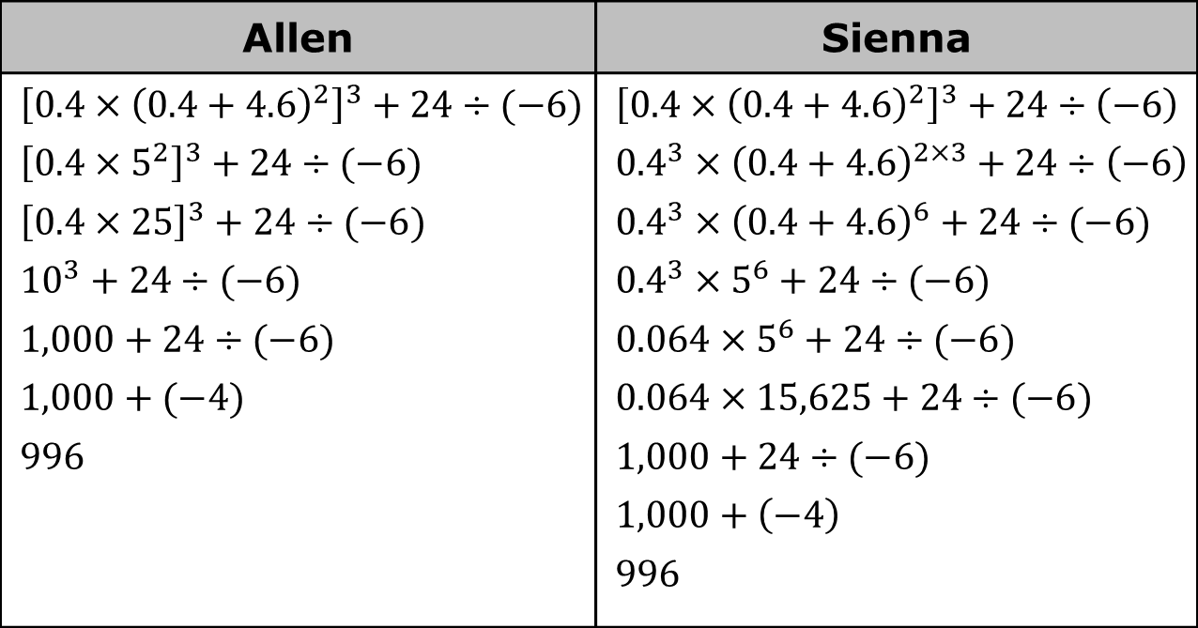
1.5.2 Guided Instruction: Evaluating Expressions
Two students evaluated the same expression in two different ways. Their work is shown.
Allen | Sienna
$${\left[0.4×{\left(0.4+4.6\right)}^{2}\right]}^{3}+24÷(−6)$$ $${\left[0.4×5^{2}\right]}^{3}+24÷(−6)$$ $${\left[0.4×25\right]}^{3}+24÷(−6)$$ $${10}^{3}+24÷(−6)$$ $$1,000+24÷(−6)$$ $$1,000+(−4)$$ $$996$$ | $${\left[0.4×{\left(0.4+4.6\right)}^{2}\right]}^{3}+24÷\left(−6\right)$$ $${0.4}^{3}×{\left(0.4+4.6\right)}^{2×3}+24÷\left(−6\right)$$ $${0.4}^{3}×{\left(0.4+4.6\right)}^{6}+24÷(−6)$$ $${0.4}^{3}×5^{6}+24÷(−6)$$ $$0.064×5^{6}+24÷(−6)$$ $$0.064×15,625+24÷(−6)$$ $$1,000+24÷(−6)$$ $$1,000+\left(−4\right)$$ $$996$$
volume 1, pg. 27

Slide 9
How were Allen’s steps and Sienna’s steps different from each other?
Discuss with your partner whether you think one method was easier to use to evaluate the expression over the other.
volume 1, pg. 27

Slide 10

Activity
volume 1, pg. 27

Slide 11

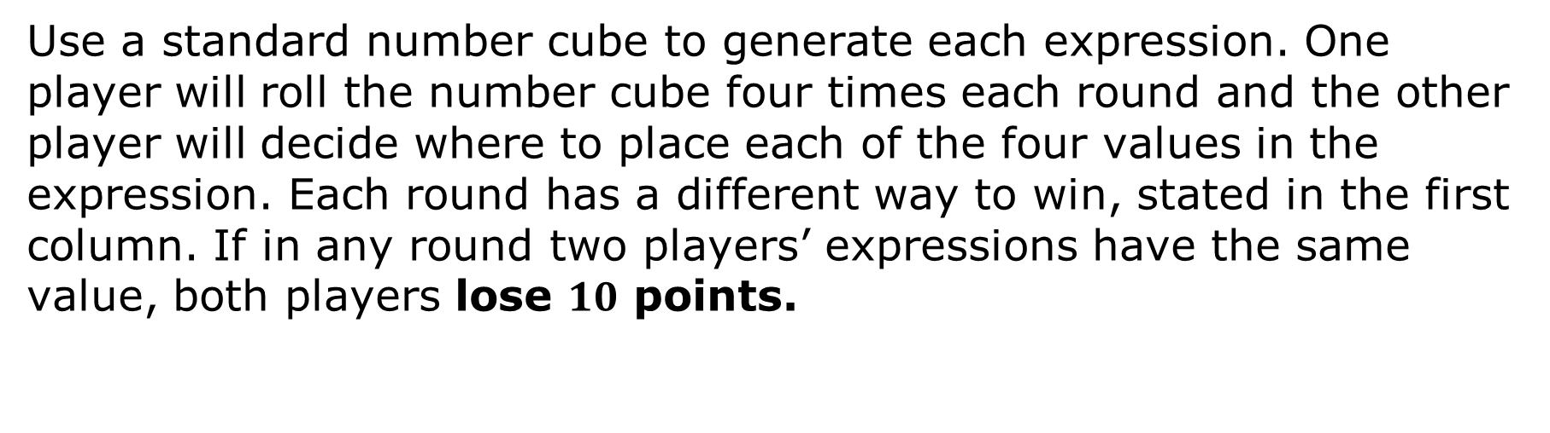
1.5.3 Activity: Expression Game
Use a standard number cube to generate each expression. One player will roll the number cube four times each round and the other player will decide where to place each of the four values in the expression. Each round has a different way to win, stated in the first column. If in any round two players’ expressions have the same value, both players lose $10$ points.
volume 1, pg. 27

Slide 12
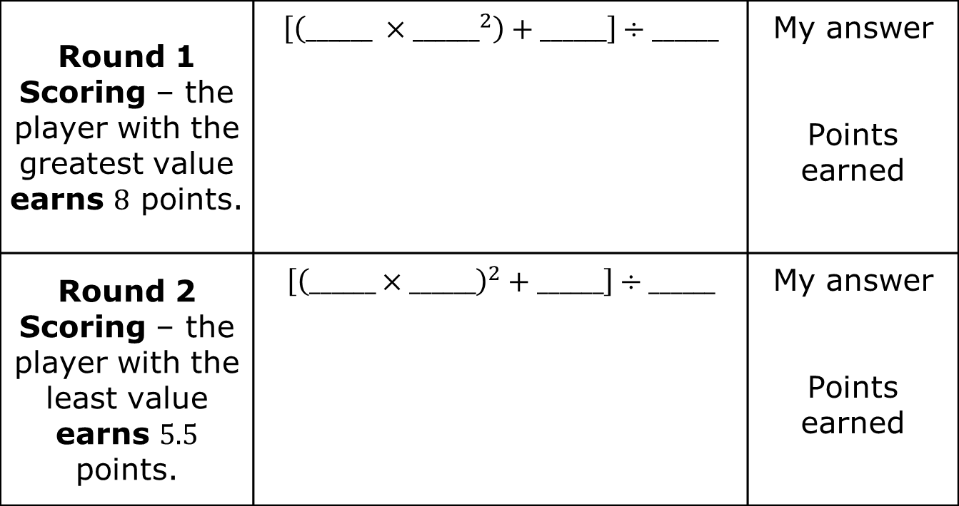
Round 1 Scoring – the player with the greatest value earns $8$ points. | $$\left[\left(______ ×{______}^{2}\right)+______\right]÷______$$ | My answer Points earned
Round 2 Scoring – the player with the least value earns $5.5$ points. | $$\left[{\left(______×______\right)}^{2}+______\right]÷______$$ | My answer Points earned
volume 1, pg. 27

Slide 13
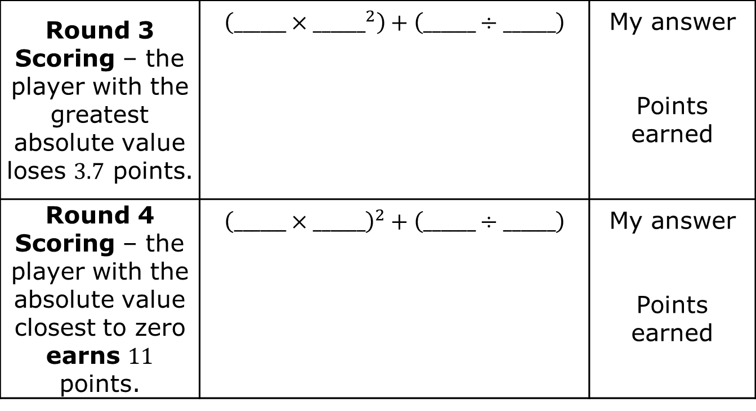
Round 3 Scoring – the player with the greatest absolute value loses $3.7$ points. | $$\left(______×{______}^{2}\right)+\left(______÷______\right)$$ | My answer Points earned
Round 4 Scoring – the player with the absolute value closest to zero earns $11$ points. | $${\left(______×______\right)}^{2}+\left(______÷______\right)$$ | My answer Points earned
volume 1, pg. 27

Slide 14
My Game Score
Round 1 | Round 2 | Round 3 | Round 4 | My Score
Discuss with the other players what strategies you used to determine where to put the numbers. Summarize your discussion.
volume 1, pg. 28

Slide 15

Try It
volume 1, pg. 28

Slide 16

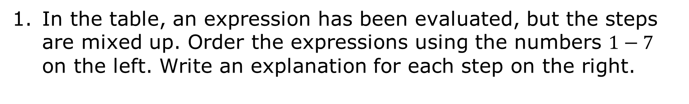
1.5.4 Try It: Using the Order of Operations
In the table, an expression has been evaluated, but the steps are mixed up. Order the expressions using the numbers $1−7$ on the left. Write an explanation for each step on the right.
volume 1, pg. 28

Slide 17
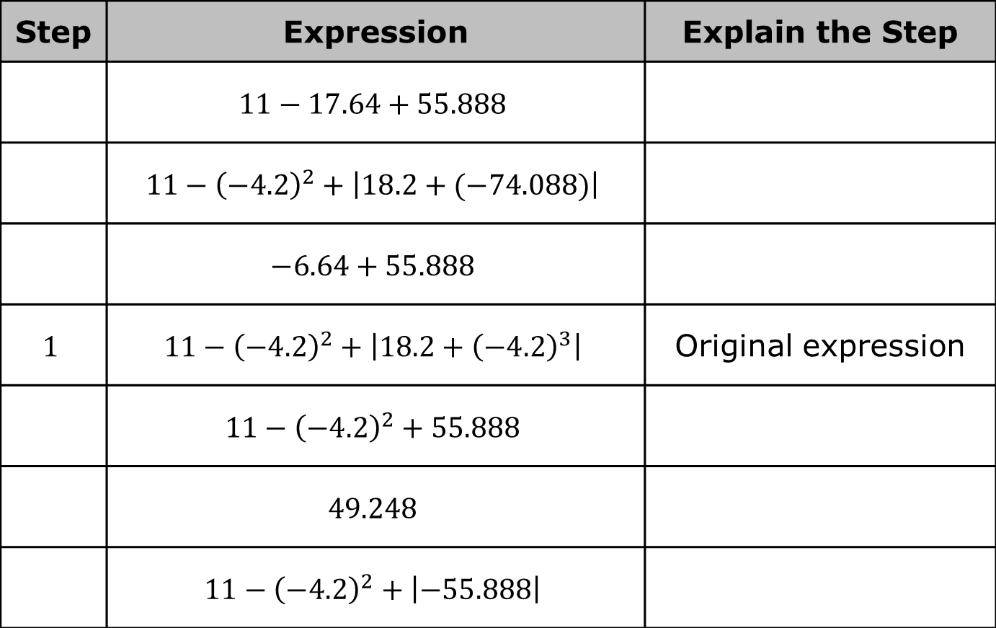
Step | Expression | Explain the Step
 | $$11−17.64+55.888$$
 | $$11−{\left(−4.2\right)}^{2}+\left|18.2+(−74.088)\right|$$
 | $$−6.64+55.888$$
$$1$$ | $$11−{\left(−4.2\right)}^{2}+\left|18.2+{\left(−4.2\right)}^{3}\right|$$ | Original expression
 | $$11−{\left(−4.2\right)}^{2}+55.888$$
 | $$49.248$$
 | $$11−{\left(−4.2\right)}^{2}+\left|−55.888\right|$$
volume 1, pg. 28

Slide 18

Evaluate each expression without using a calculator.
a. ${\left(\frac{2}{3}\right)}^{3}×54−4^{2}$
b. $19−\left(5−4^{2}\right)+\frac{3^{2}}{6}$
volume 1, pg. 29

Slide 19
Activity
volume 1, pg. 29

Slide 20
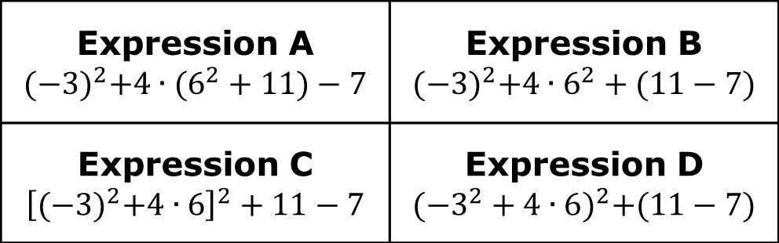
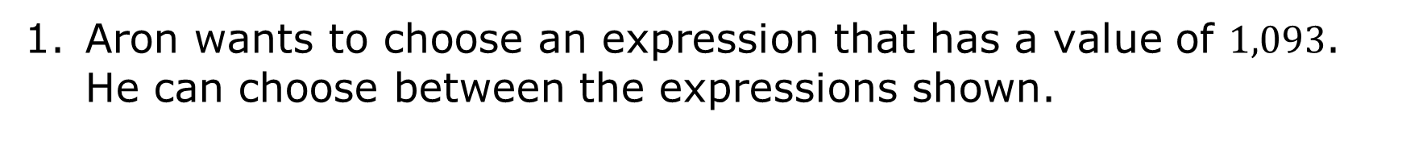
1.5.5 Activity: Class Debate
Aron wants to choose an expression that has a value of $1,093$. He can choose between the expressions shown.
Expression A $${{(−3)}^{2}+4∙(6}^{2}+11)−7$$ | Expression B $${{(−3)}^{2}+4∙6}^{2}+(11−7)$$
Expression C $${\left[{(−3)}^{2}+4∙6\right]}^{2}+11−7$$ | Expression D $${({−3}^{2}+4∙6)}^{2}+(11−7)$$
volume 1, pg. 29

Slide 21
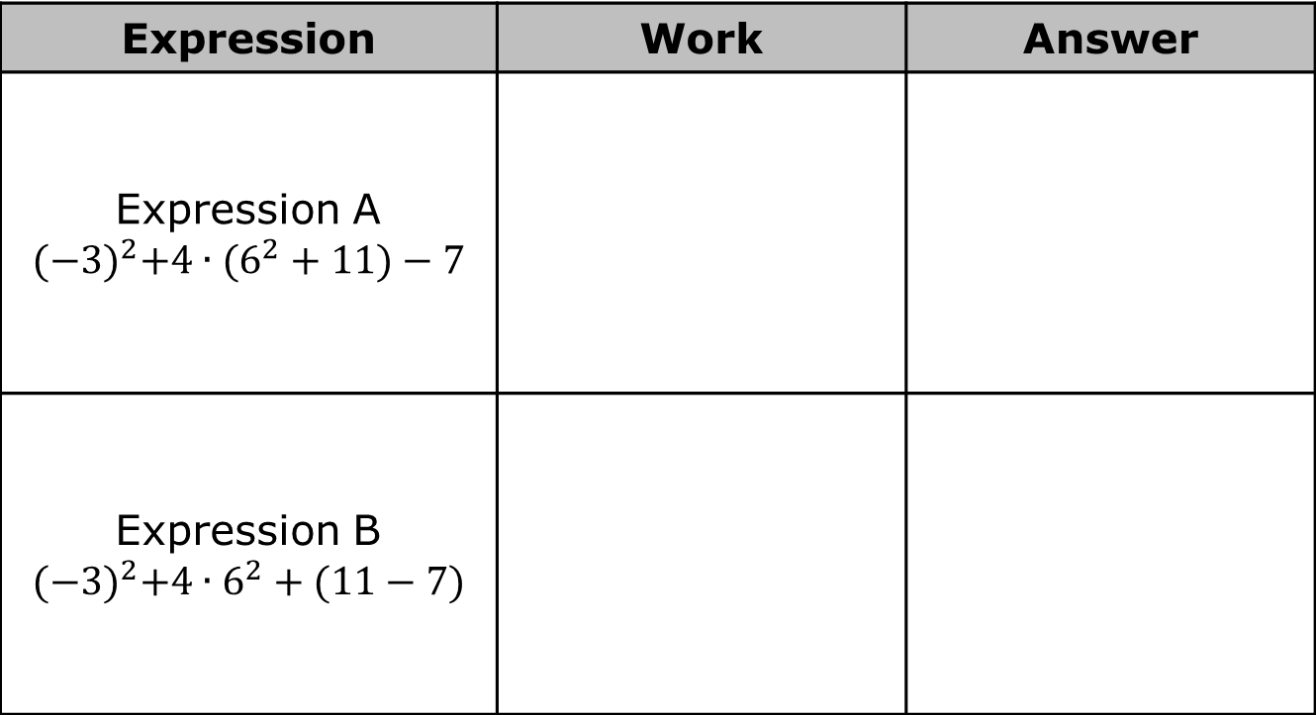
Evaluate each expression. Record your answers in the table.
Expression | Work | Answer
Expression A $${{(−3)}^{2}+4∙(6}^{2}+11)−7$$
Expression B $${{(−3)}^{2}+4∙6}^{2}+(11−7)$$
volume 1, pg. 29

Slide 22
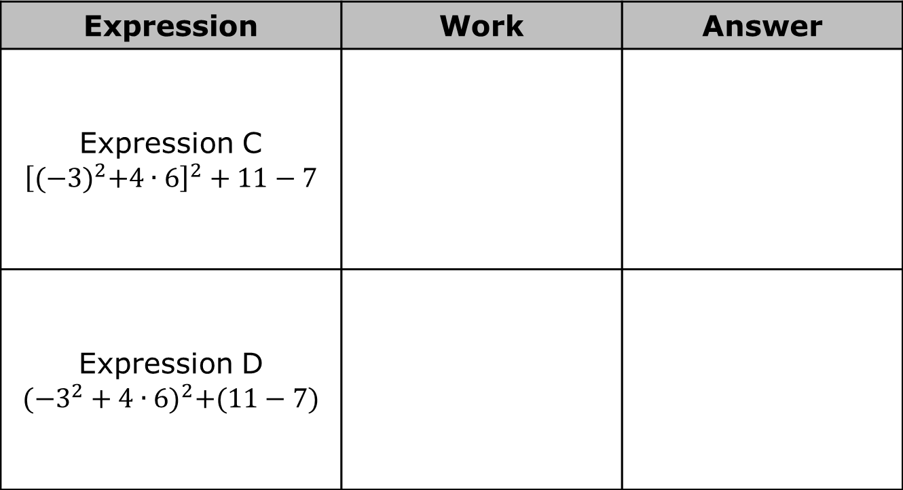
Expression | Work | Answer
Expression C $${\left[{(−3)}^{2}+4∙6\right]}^{2}+11−7$$
Expression D $${({−3}^{2}+4∙6)}^{2}+(11−7)$$
Which expression should Aron choose? _________
volume 1, pg. 30

Slide 23

Wrap-Up
volume 1, pg. 30

Slide 24
1.5.6 Wrap-Up: Reflection
Complete each statement based on your learning today.
A barrier to my learning was …
I will try to overcome this by …
volume 1, pg. 30

